Slide 1
AdaBoost (Adaptive Boosting)
A powerful ensemble learning method that combines weak learners to form a strong classifier.

Slide 2
Steps in AdaBoost
1. Initialize weights
2. Train weak learner
3. Compute error
4. Compute alpha
5. Update weights
6. Repeat

Slide 3
Weak Learner
Simple model (e.g., decision stump)
Accuracy slightly better than random guessing.

Slide 4
Weight Update
Correct prediction: decrease weight
Wrong prediction: increase weight
Helps next learner focus on hard samples

Slide 5
Final Model
F(x) = α1h1(x) + α2h2(x) + ... + αThT(x)
Final prediction = sign(F(x))

Slide 6
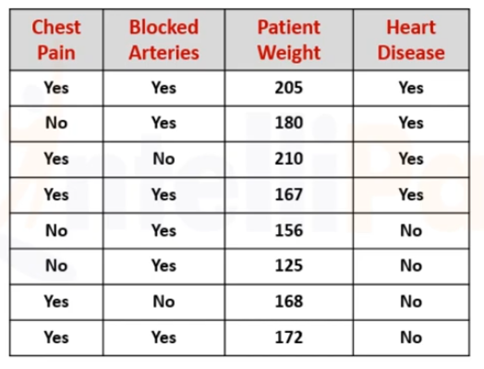
Example

Slide 7
Decision Stump
If ChestPain = Yes , Predicted =Yes
If BlockedArteries = Yes , Predicted =Yes
If Weight > 160, Predicted =Yes

Slide 8
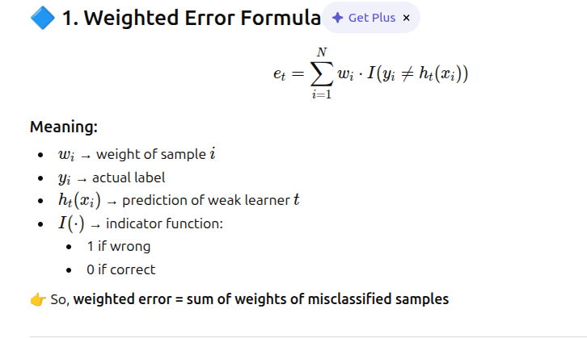
Steps

Slide 9
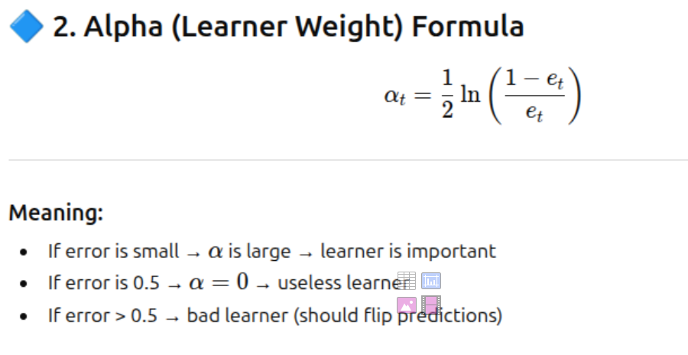

Slide 10
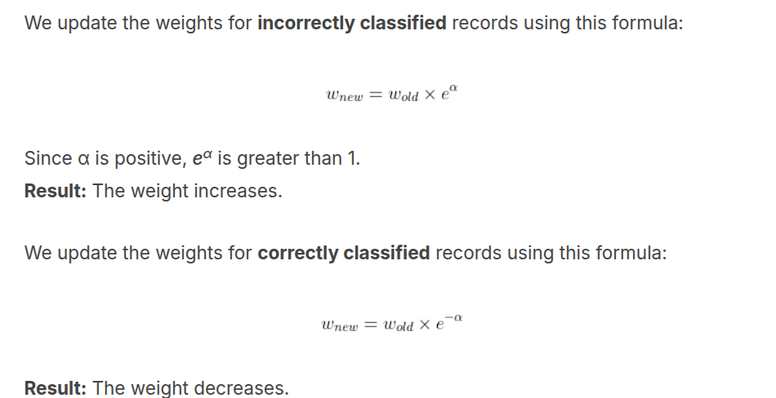
Step 3 - Weight Update

Slide 11
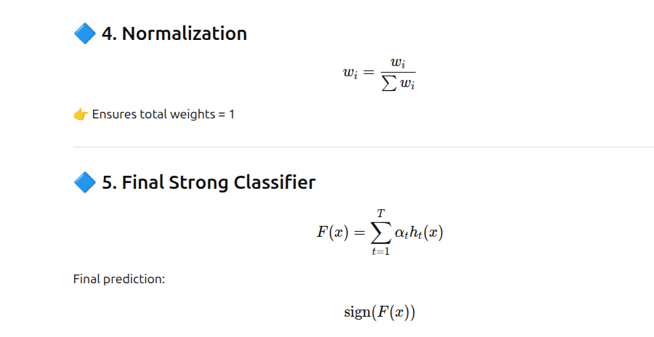
ht(x) is the prediction made by the t-th weak learner.
h = individual weak learner prediction

Slide 12
Weak Learners
h1- If ChestPain = Yes , then Predicted =Yes else No
h2-If BlockedArteries = Yes , then Predicted =Yes else No
h3-If Weight > 160, then Predicted =Yes else No

Slide 13
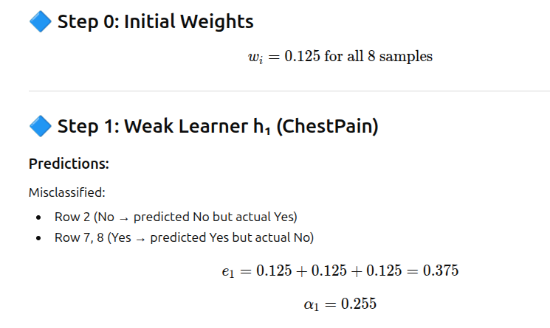

Slide 14
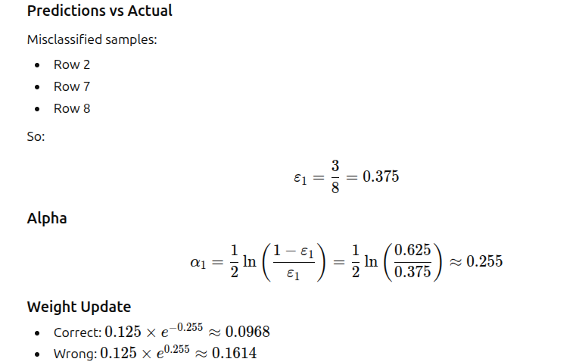
Weight Learner 1 -Chest Pain

Slide 15
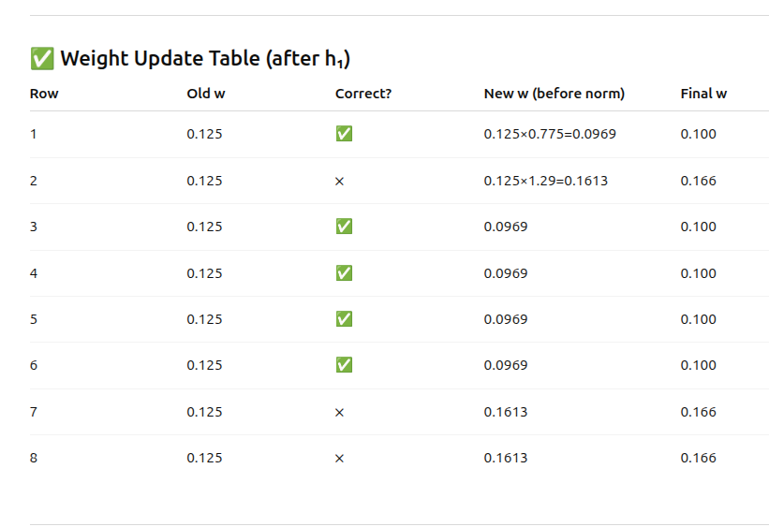

Slide 16
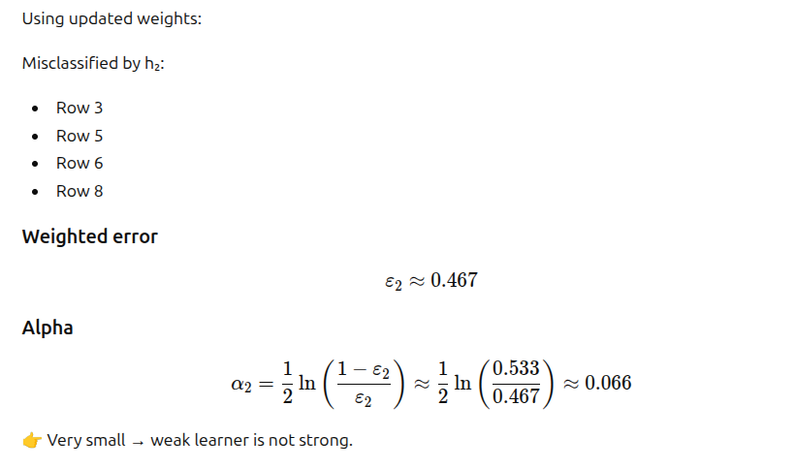
Weak Learner 2 – Blocked Arteries

Slide 17
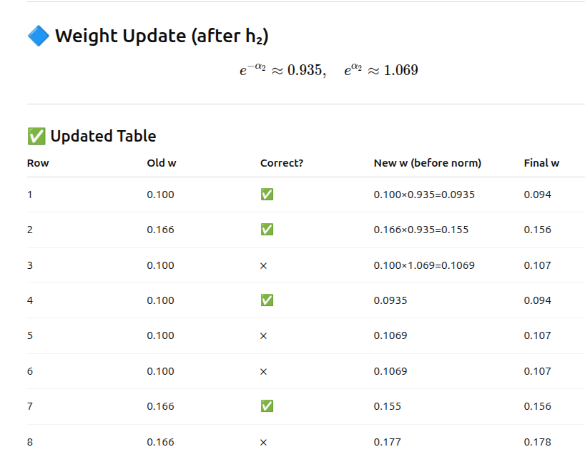

Slide 18
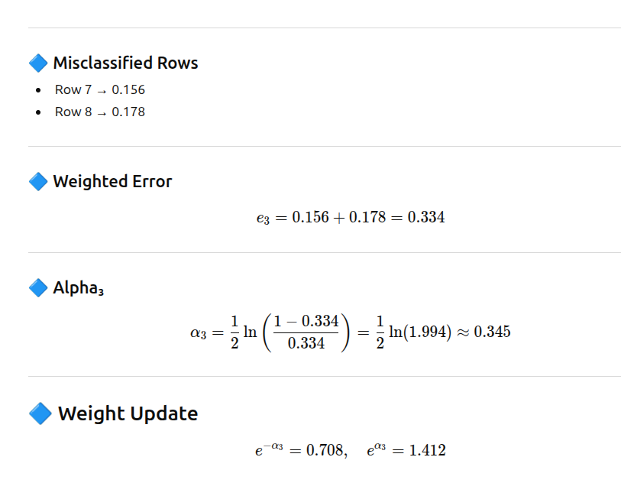
Weak learner 3 - Weight >160

Slide 19
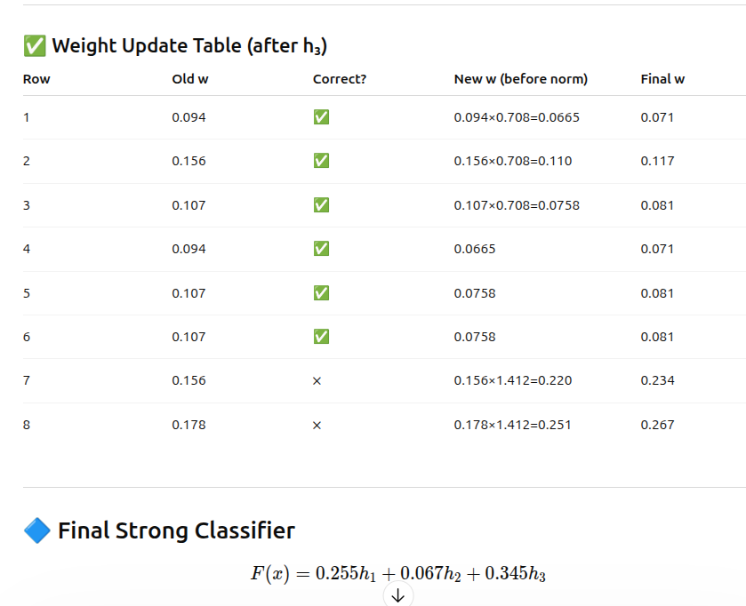


Slide 20
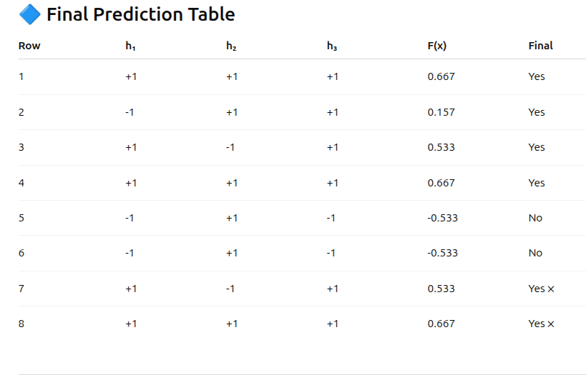
IF F(X) >0, THEN YES. IF F(X)<0, THEN NO.

Slide 21
Advantages
High accuracy
Reduces bias and variance
Works well with simple models

Slide 22
Disadvantages
Sensitive to noise
Can overfit if too many iterations

